Slide 1
Bug Tracking System
Ujjwal Gupta(19BCE0611)

Slide 2
Abstract
Bug tracking system is a web-based application which aims to help the developers and project managers to manage the bugs efficiently. For large projects there are many versions that are planned to be released so there may be bugs that have occurred in the software over the time so whoever in the team who found the bug can report on the software and the team which is responsible for that part. There will be many features like reporting a bug, setting a priority of the bug, status of the bug like open or closed and bug description. This software is a submodule of control version where main emphasis is on version control whereas in bug tracking system, we will have main emphasis on bug that have occurred over different version.

Slide 3
Objective
The Bug Tracking System is developed to easy out the process for a developer to maintain his bugs and version for a project throughout development of the project. The Bug Tracking system is a standalone webbased software which works with a database. As long as client want the software to be offline, he can store unlimited amount of data. The software can manage many projects for the client. One of the Aim for this software is also to provide good user interface for the client because there are many tracking systems who either work on CLI or have complicated user interface. The result of the project can be summarized as follows:
User can create different project and switch between them.
User can add bugs for the version created.
User will get the count of active bug for each and every version.
User can view versions and bugs according project.

Slide 4
Motivation
There are lot of bugs and version control system open source but many of them are complicated and some of them works with command line interface. The main motivation for this project was to provide a good user interface and easy software for client to handle. This software can be used by any type of developer need not be software and for any number of projects as there are very few paid software which provide this feature.

Slide 5
Background
The software Bug Tracking System is made web based because standalone application consumes more memory and are more complicated to build. Another reason is everyone have at least one web browser installed in his/her system so this software is very easy to run because its web based. The user must install any SQL database as this software requires data to be stored in SQL format for which postgres SQL is preferred.

Slide 6
Project Description and Goal
Bug tracking system is a web-based application which aims to help the developers and project managers to manage the bugs efficiently. For large projects there are many versions that are planned to be released so there may be bugs that have occurred in the software over the time so whoever in the team who found the bug can report on the software and the team which is responsible for that part. There will be many features like reporting a bug, setting a priority of the bug, status of the bug like open or closed and bug description. This software is a submodule of control version where main emphasis is on version control whereas in bug tracking system, we will have main emphasis on bug that have occurred over different version.

Slide 7
Technical Specification
There are many features of the software: -
The system shall allow the developers to Login into the system.
The system shall allow developers to create a new project.
The system shall allow the developers to view the bugs.
The system shall allow the developers to report the bug.
The system shall allow the developers to view the versions.
The system shall allow the developers to add versions.
The following are few points which are out of scope for product: - •
The system will not be responsible for how the bug should be resolved.
The system will not store the files of project.
The system will not track the files of project.

Slide 8
Technologies Used:
Frontend: HTML5, CSS3, JavaScript
Backend: NodeJS
Database: PostgreSQL
Packages | Version
body-parser | 1.19.0
ejs | 3.1.6
express | 4.17.1
method-override | 3.0.0
pg | 8.6.0

Slide 9
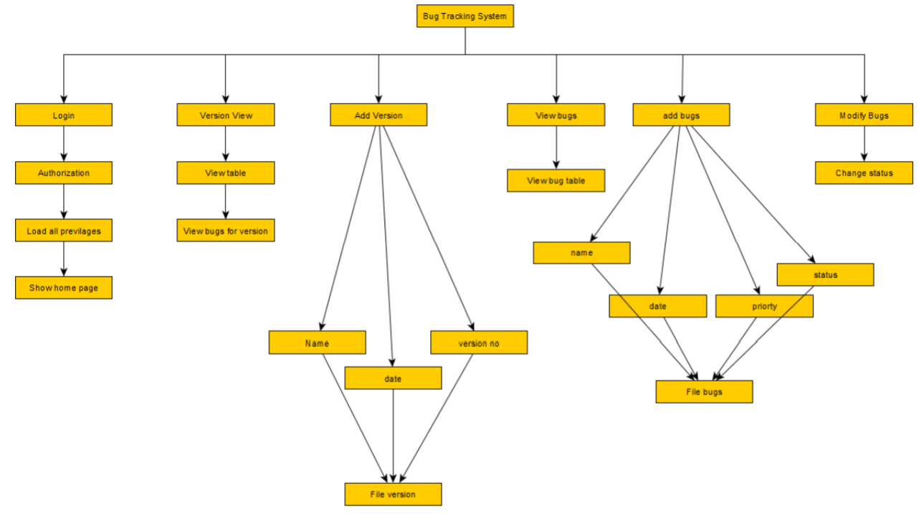
Design Approach
Work Breakdown Structure

Slide 10
All Modules of Bug tracking System:
Login Authentication Module
View version Module
Add version module
Edit version module
Add bugs Module
Change status of bugs module
Delete Bug Module
Add project

Slide 11
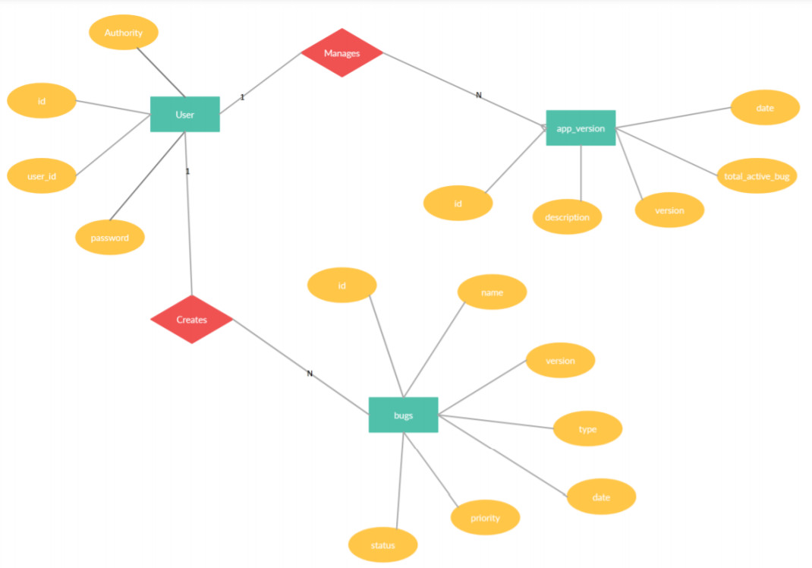
ER Diagram

Slide 12
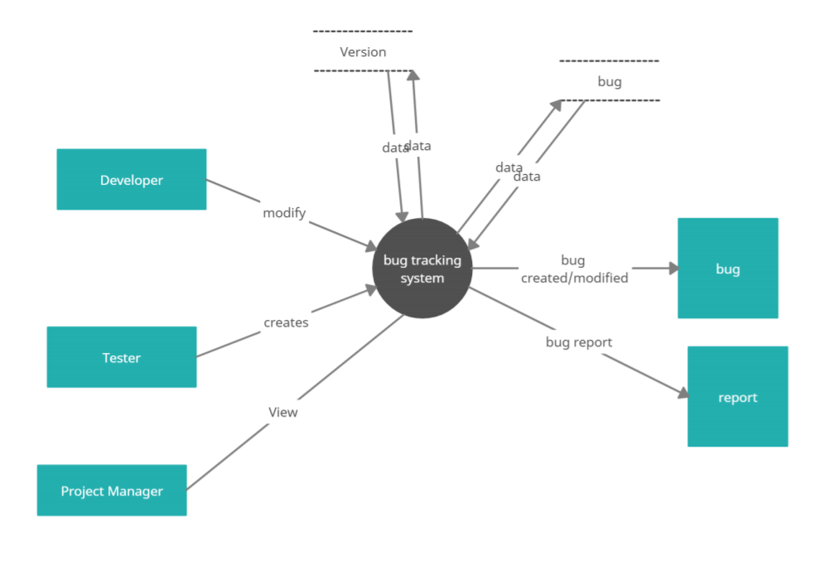
Dataflow Diagram

Slide 13
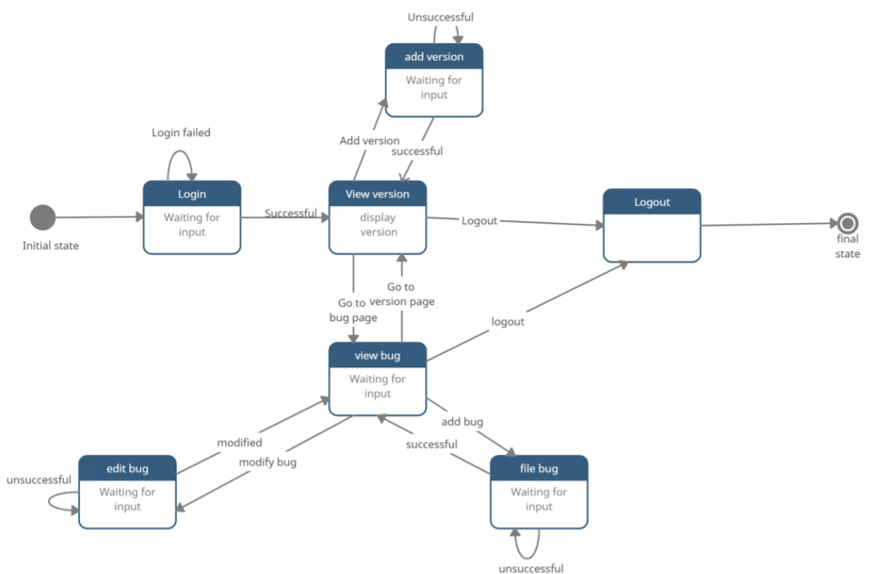
State Transition Diagram

Slide 14
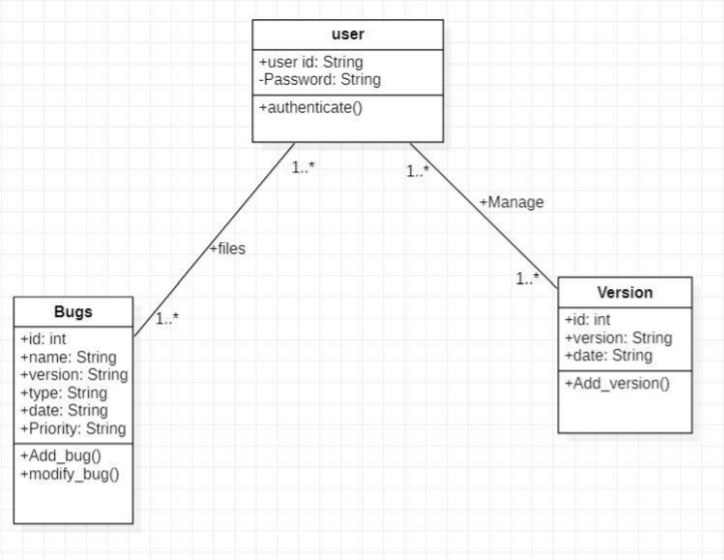
Class Diagram

Slide 15
Constraints
Design Constraint | Description
Database constraint | As PostgreSQL only allows 10,000 rows free so the software can only store total 10,000 rows for free if the client is using online bug tracking system. For offline storage is unlimited.

Slide 16
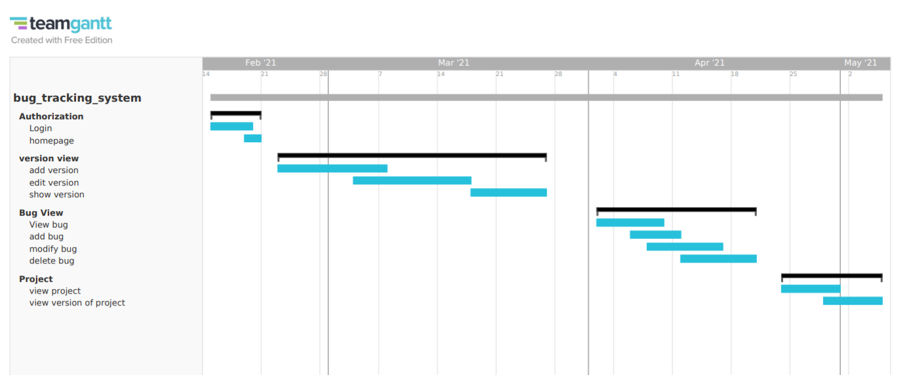
Schedule Task And Milestone

Slide 17
There were multiple task like Authorization module, adding version, editing version and so on. Each task is done individually without the dependency of other modules hence the Bug Tracking system can be divided into 3 subpart – Version, bugs and project. After completing all the task these modules were linked through database.
Milestones-:
There were 3 milestone and 1 deliverable.
Milestones are -:
Milestone 1 – User is able to login and make a new version.
Milestone 2 – User is able to file the bug for each and every version.
Milestone 3 – User is able to create multiple project and can add version to it hence linking all three modules.
Deliverable are :-
Deliverable 1 – User is able to fully manage all project and manage all version and bugs through portal.

Slide 18
Test Report
TEST CASE ID | TEST OBJECTIVE | TEST DATA | EXPECTED RESULT | ACTUAL RESULT | PASS/FAIL
1 | Test Authentication of Software | User id: test Password: test | Login Successfully | Login Successfully | Pass
2 | Test View Version Page | http://localhost:3000/portal/version | Successfully shows all the details of all versions. | Successfully shows all the details of all versions. | Pass
3 | Test View Bug Page | http://localhost:3000/portal/bug | Successfully shows all the details of all bugs added by user. | Error: No Table to show | Fail
4 | Test View Bug Page (With database error fixed) | http://localhost:3000/portal/bug | Successfully shows all the details of all bugs added by user. | Successfully shows all the details of all bugs added by user. | Pass
5 | Test add version module of software | Name: Database Integration Version no: 1.1.0 Release Date: 2021-05-08 Comment: TEXT | Successfully add the version details. | Successfully added. | Pass

Slide 19
TEST CASE ID | TEST OBJECTIVE | TEST DATA | EXPECTED RESULT | ACTUAL RESULT | PASS/FAIL
6 | Test edit version Module of Software | Name: Database Integration (SQL) Version no.: 1.1.0 Release Date: 2021-05-08 Comment: TEXT | Changes Successfully reflected on main page | Changes Reflected on main Page. | Pass
7 | Test add bug Module of Software | Name: No data received Version no: 1.1.0 Bug priority: Very High Comment: No data received from database Bug type: functional | Successfully register the Bug | Successfully Register the Bug. | Pass
8 | Test Modify Status of bug module and accordingly changes in version table | Id: B-4 Status: Resolved | Successfully change status on bug table and show correct active bug in version table for that version | Successfully changes status on bug table but does not change no of active bugs on version. | Fail
9 | Again, test modify status of module after fix. | Id: B-4 Status: Resolved | Successfully change status on bug table and show correct active bug in version table for that version | Successfully change status on bug table and show correct active bug in version table for that version | Pass

Slide 20
Demonstration
Link of Live Demonstration:
https://youtu.be/dUulRcYzd-M

Slide 21
Cost analysis/ Result
Cost Analysis:
During development of this project we have used all the open source tool so the cost of development of this product was almost 0$.
For the client if he want to host the application online we have to consider the following cost - :
Cost of domain name.
Cost of online database (up to 10000 rows are free after that paid)
Server cost ( 2000 request per day is free after that paid)
But as long as client want to use the software offline there is almost no cost in running the application.
Result:
The project bug tracking system was started so that will ease out the process of managing bug and version for the developer and at the end it fulfill all the purpose and requirements it was intended. For future work we will work on this project to make is collaborative and the system can assign role for the person so that each and every team member can work on that software.

Slide 22
Thankyou

